Slide 1
李晓菲-Week2
2020-4-4

Slide 2
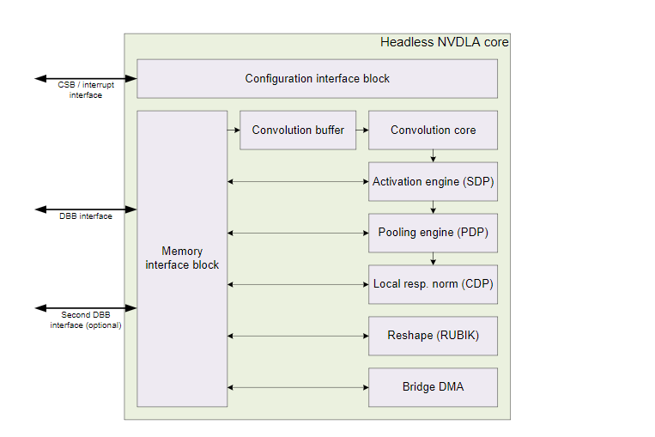
Hardware Architecture
two modes of operation:
independent mode
fused mode

Slide 3
Connections
Configuration Space Bus (CSB) interface.(旨在供CPU用于访问NVDLA配置寄存器)
Interrupt interface. (中断接口)
Data Backbone (DBB) interface.
has an optional second connection which can be used when there is a second memory path available. （can be removed if not necessary)

Slide 4
Components
Convolution
SDP: The Single Data Point Processor
PDP: The Planar Data Processor
CDP:The Cross-channel Data Processor
Data Reshape Engine
DMA:Bridge DMA

Slide 5
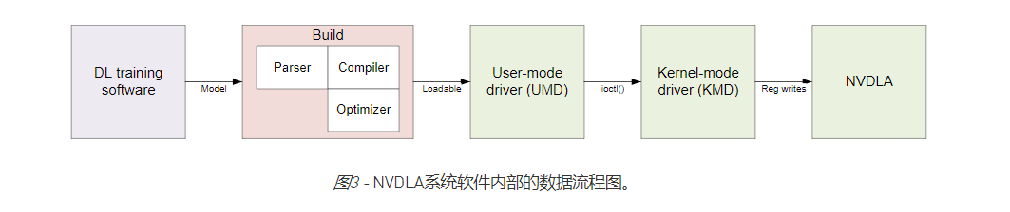
Software Design
two groups:
the compilation tools (model conversion)
the runtime environment (run-time software to load and execute networks on NVDLA).

Slide 6
